Slide 1
Traffic Safety: City of Chicago
Erika Haren
Will Skrab
Caitlin Hemler
Robert Wood

Slide 2
Project Description
Study of traffic in the City of Chicago, including congestion data, crash data, and traffic cameras, using data made publicly available by the City of Chicago.

Slide 3
Data Sources
data.cityofchicago.org:
Red Light Camera Locations
Red Light Camera Violations
Speed Camera Locations
Speed Camera Violations
Traffic Crashes – Crashes
Traffic Crashes – People
Traffic Crashes – Vehicles
Congestion Estimates by Region

Slide 4
Questions considered
In what areas are crashes more/less common? Does this correlate to congestion?
Is there a correlation between red light cameras and number of violations?
Is there a correlation between speed cameras and number of violations?
What are the average congestion levels throughout the year? Do these correlate to the number of crashes?

Slide 5
Process
Gather data from data.cityofchicago.org, via the Socrata Open Data API (SODA) or direct .csv download
Import and review data using Jupyter Notebook and Pandas
Evaluate scope of available data (reporting years, keys to link datasets)
Clean datasets
Remove NaN and ‘0’ values
Filter timeframe of data as needed to remove partial year reporting
Parse resulting data, link dataframes to determine answers to the questions posed
Visualize data using Matplotlib and Google Maps

Slide 6
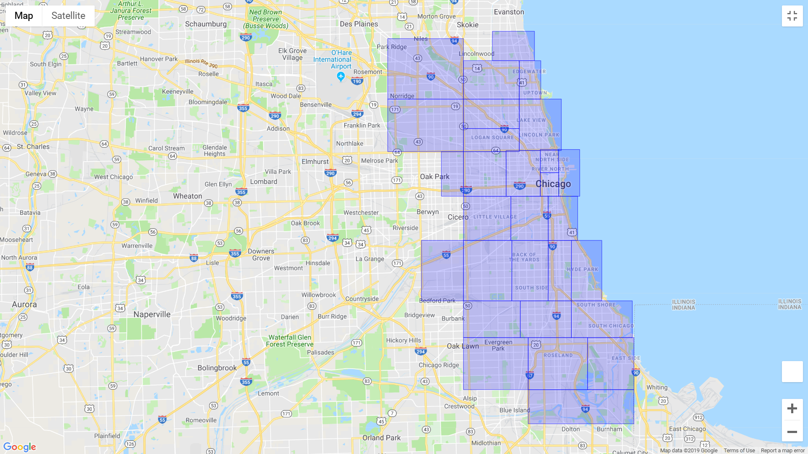
Traffic Regions
29 regions, defined by the City of Chicago

Slide 7
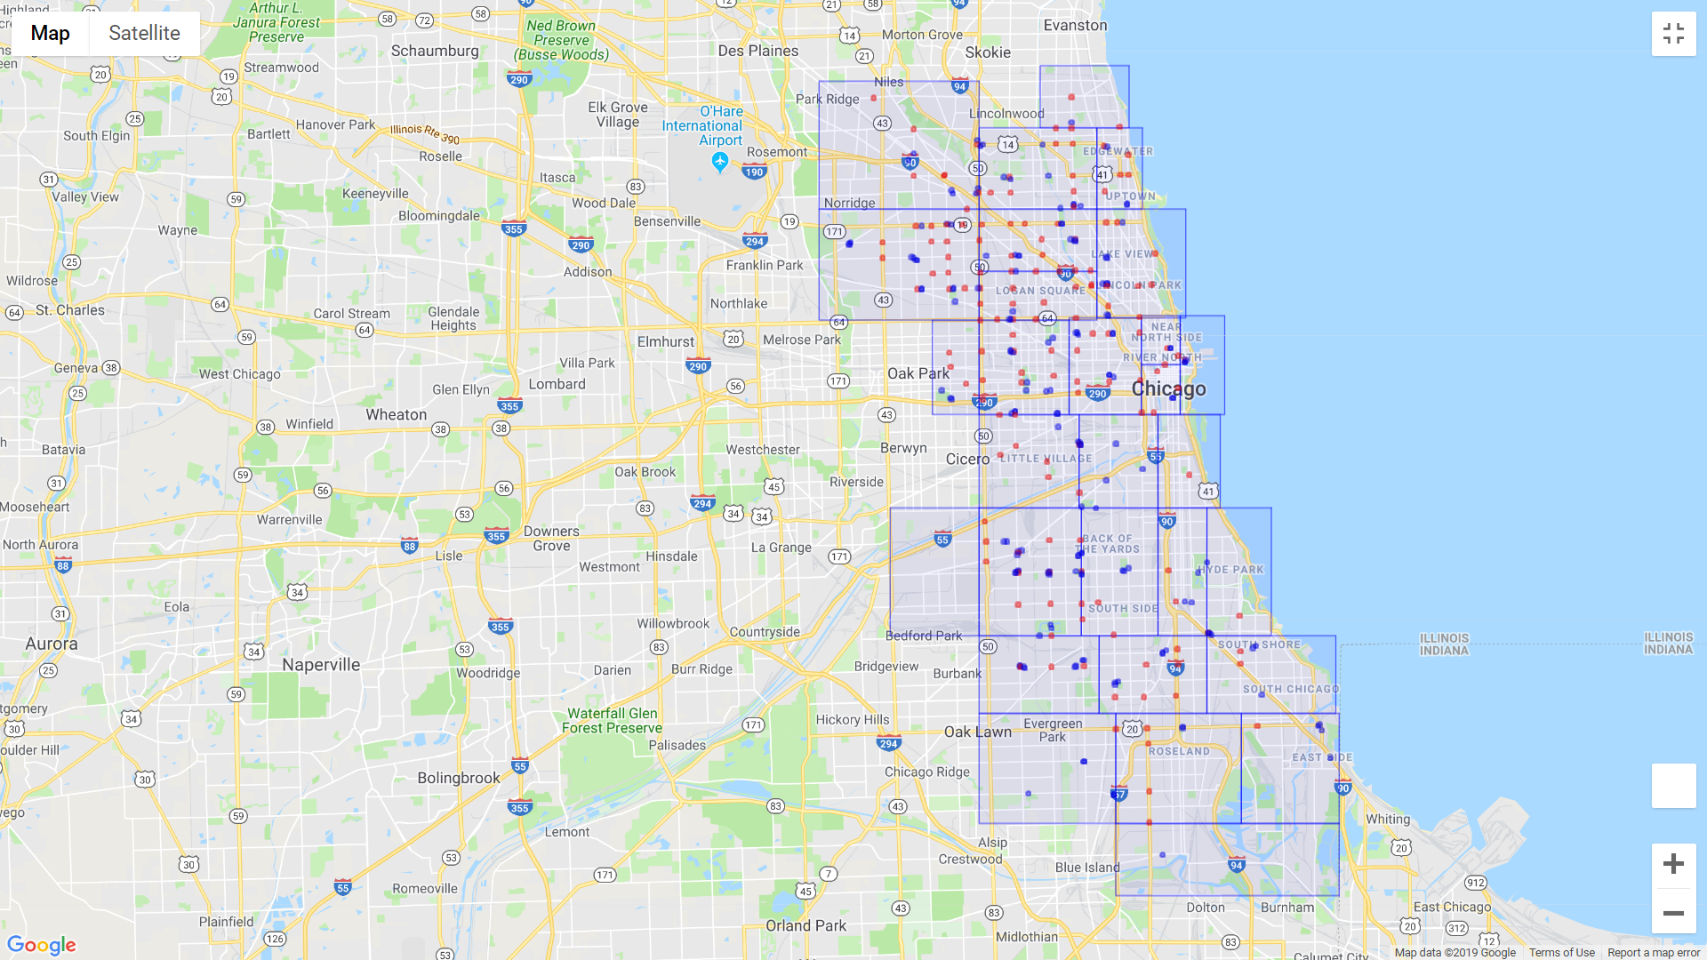
Traffic Regions, Incl. Red Light and Speed Cameras
Red Light Cameras
Speed Cameras
29 regions, defined by the City of Chicago

Slide 8
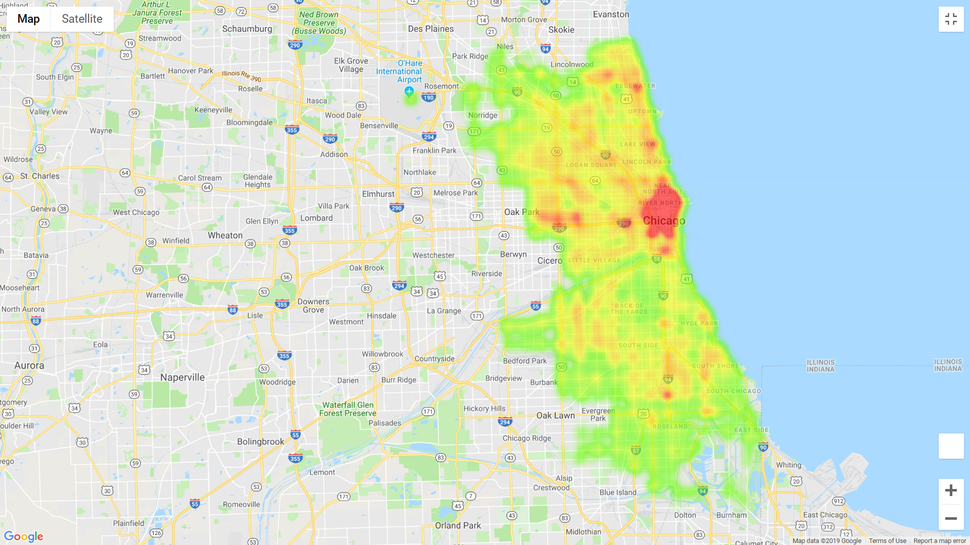
Traffic Crashes
Heatmap of traffic crashes in the City of Chicago, 2017-present

Slide 9
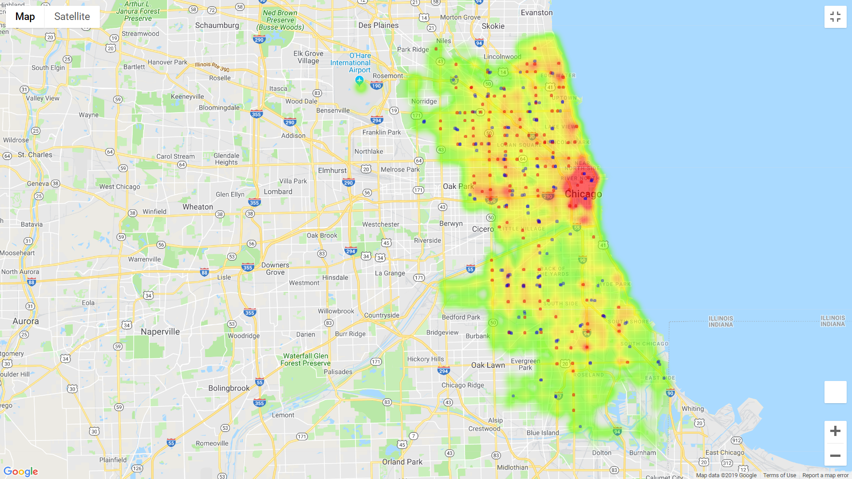
Traffic Crashes, Incl. Red Light and Speed Cameras
Red Light Cameras
Speed Cameras
Heatmap of traffic crashes in the City of Chicago, 2017-present, including red light cameras and speed cameras

Slide 10
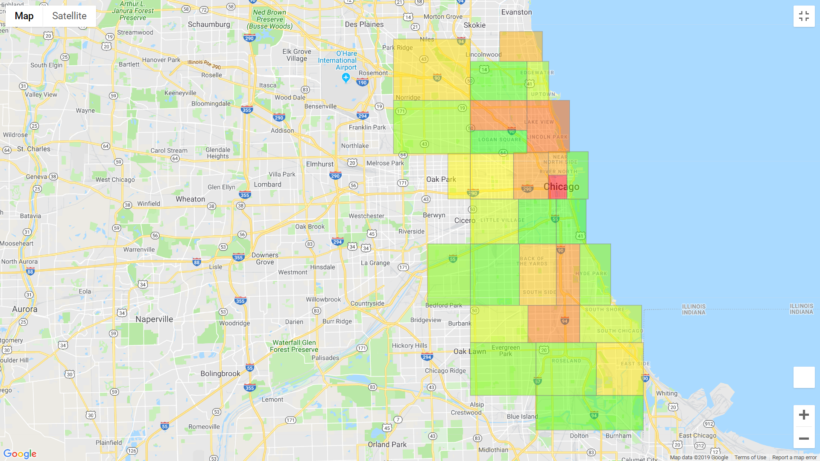
Traffic Crashes involving Drunk Drivers
Fewer Crashes | More Crashes
Choropleth map of traffic crashes involving drunk drivers (BAC > .08) in the City of Chicago, by region

Slide 11
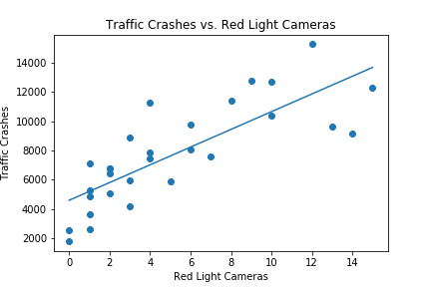
Crashes vs. Red Light Cameras

Slide 12
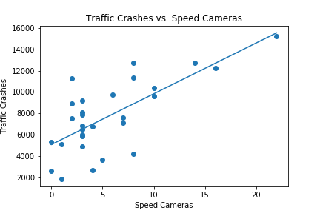
Crashes vs. Speed Cameras

